Slide 1

MACHINE LEARING FOR WEB VULNERABILITY DETECTION
PROJECT GUIDE :
Ms. V Aparna Varalakshmi (Associate Professor)
PRESENTED BY : 1. Appidi Giridhar Reddy – 2081A0546 2. Pathapati Bhanuteja – 20841A0532 3. S Sai Sreekar – 20841A0560

Slide 2
Index
System Architecture
Modules
UML Diagrams
Output
Test Cases
Conclusion

Slide 3
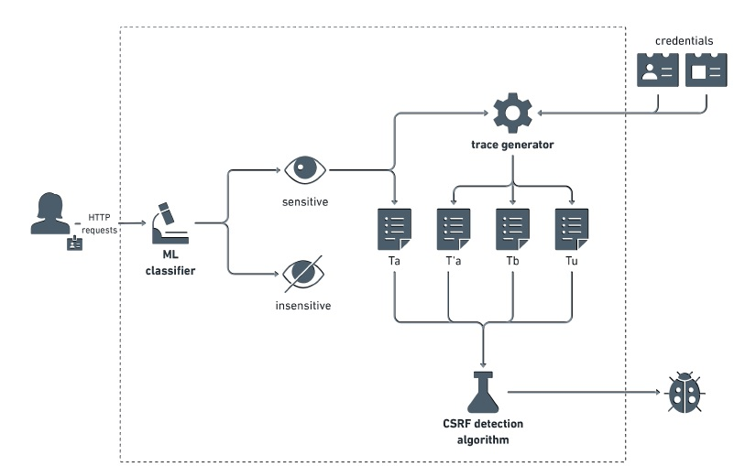
1. System Architecture

Slide 4
Explanation of the System Architecture:
1)Dissimilar Responses: Mitch focuses on detecting dissimilar HTTP responses rather than trying to precisely match them. This is because responses may differ due to dynamically generated elements or status codes denoting failures.
2)Session State Consideration: Mitch acknowledges that Bob's session might have a different state compared to Alice's. Therefore, it doesn't immediately attribute response dissimilarity to a CSRF protection mechanism. It also replays Alice's request in a fresh session to account for potential session-dependent information.
3)Classification Verification: Mitch accounts for potential classification errors by replaying Alice's request without authentication. If the response differs from the original, it indicates the operation required an authenticated context, strengthening the evidence for a potential CSRF vulnerability.

Slide 5
2. Modules
There are four types of modules used in this project. They are :
User
Admin
False Positives and False Negatives
Machine Learning Classifier

Slide 6
1. User –
Users register with valid email and mobile for communication. Admin approval activates accounts. Post activation, users log in, conduct data preprocessing, and input the website name for CSRF testing. The Bolt tool retrieves related CSRFs, generating algorithm names, and results are stored in JSON files. Additionally, users can access and review Mitch dataset results directly in the browser.
2. Admin –
Admin can login with his credentials. Once he login he can activate the users. The activated user only login in our applications. The admin can set the training and testing data for the project of the Mitch Dataset. The user search all urls related csrf token admin can view in his page. The admin can also check the POST method performed data from the dataset and GET method related data also.
3. False Positives and False Negatives -
Mitch occasionally flags false positives, indicating potential CSRFs that can't be exploited. While these can be identified through manual testing, it's a laborious process. Distinguishing false negatives is challenging since knowing all CSRF vulnerabilities on tested sites is impractical. To address this, we monitor sensitive requests flagged by Mitch's ML classifier and prioritize them for manual testing. This approach is backed by the classifier's strong performance in standard validity assessments.
4. Machine Learning Classifier –
Mitch's ML classifier was trained on 6000 labeled HTTP requests from existing websites. The feature space comprises 49 dimensions, categorized into numerical features including total parameters, boolean-bound parameters, identifier-bound parameters, blob-bound parameters, and overall request length.

Slide 7
3. UML Diagrams
UML stands for Unified Modeling Language. UML is a standardized general-purpose modeling language in the field of object-oriented software engineering. The standard is managed, and was created by, the Object Management Group.
The goal is for UML to become a common language for creating models of object oriented computer software. In its current form UML is comprised of two major components: a Meta-model and a notation. In the future, some form of method or process may also be added to; or associated with, UML.
The Unified Modeling Language is a standard language for specifying, Visualization, Constructing and documenting the artifacts of software system, as well as for business modeling and other non-software systems.
The UML represents a collection of best engineering practices that have proven successful in the modeling of large and complex systems. The UML is a very important part of developing objects oriented software and the software development process. The UML uses mostly graphical notations to express the design of software projects.

Slide 8
Use Case Diagram:
A use case diagram in the Unified Modeling Language (UML) is a type of behavioral diagram defined by and created from a Use-case analysis. Its purpose is to present a graphical overview of the functionality provided by a system in terms of actors, their goals (represented as use cases), and any dependencies between those use cases. The main purpose of a use case diagram is to show what system functions are performed for which actor. Roles of the actors in the system can be depicted.

Slide 9
2. Class Diagram:
In software engineering, a class diagram in the Unified Modeling Language (UML) is a type of static structure diagram that describes the structure of a system by showing the system's classes, their attributes, operations (or methods), and the relationships among the classes. It explains which class contains information.

Slide 10
3. Sequence Diagram:
A sequence diagram in Unified Modeling Language (UML) is a kind of interaction diagram that shows how processes operate with one another and in what order. It is a construct of a Message Sequence Chart. Sequence diagrams are sometimes called event diagrams, event scenarios, and timing diagrams.

Slide 11
4. Activity Diagram:
Activity diagrams are graphical representations of workflows of stepwise activities and actions with support for choice, iteration and concurrency. In the Unified Modeling Language, activity diagrams can be used to describe the business and operational step-by-step workflows of components in a system. An activity diagram shows the overall flow of control.

Slide 12

4. Output
1. Home Page:

Slide 13
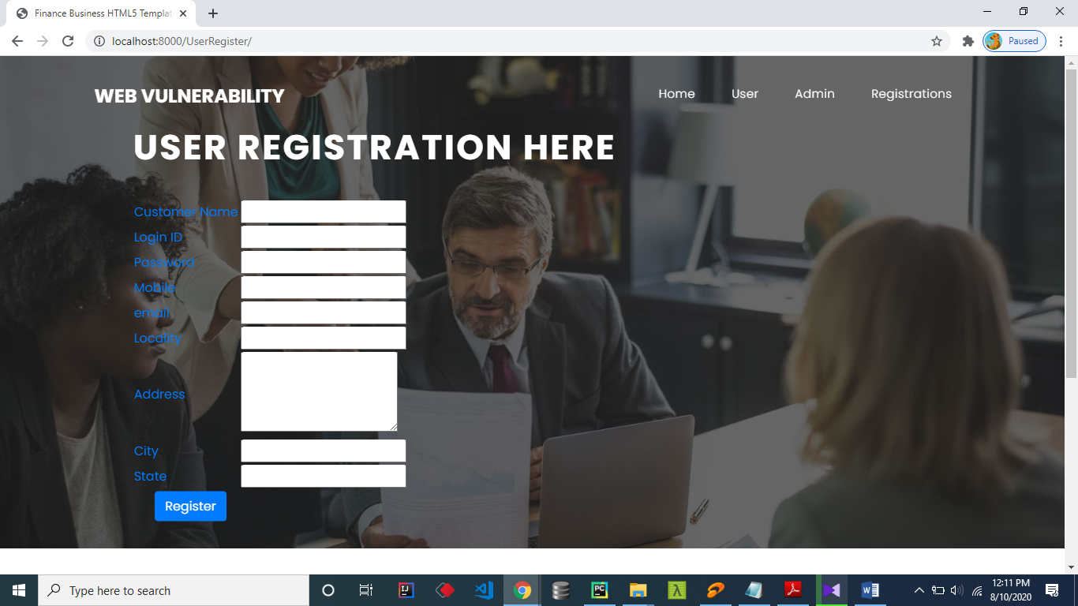
2. User Registration Form:

Slide 14
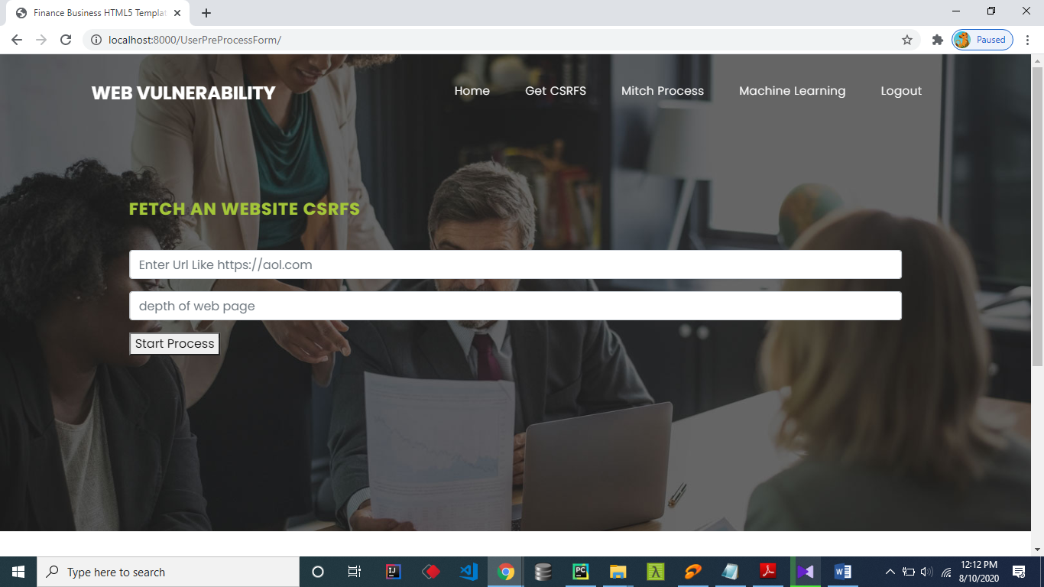
3.Getting website CSRFs:

Slide 15
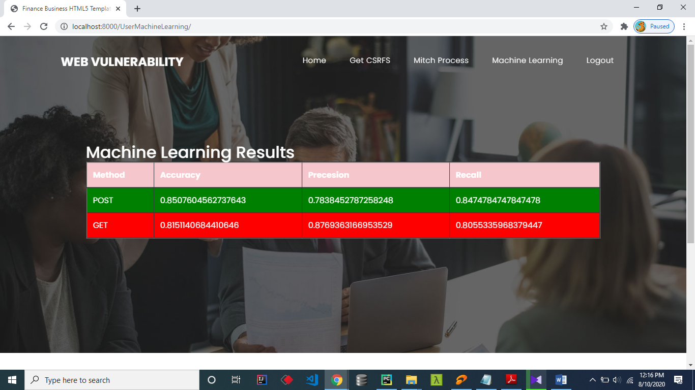
4. Machine Learning Results:

Slide 16
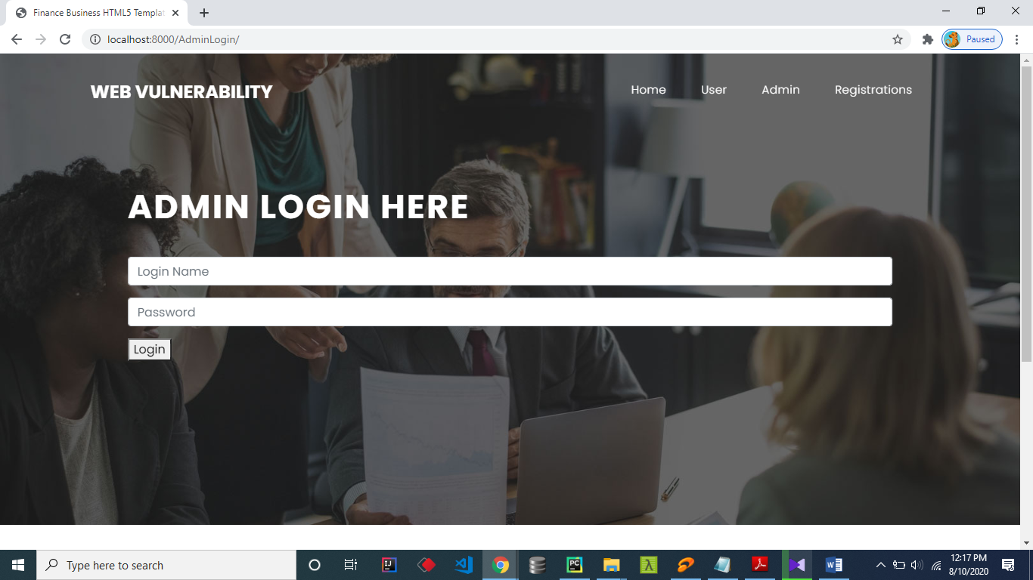
5. Admin Login:

Slide 17
5. Test Cases
S.no | Test Case | Excepted Result | Actual Result | Result | Remarks(IF Fails)
1. | User Register | If User registration successfully. | User login satisfies then successful | Pass | If already user email exist then it fails.
2. | User Login | If User name and password is correct then it will getting valid page. | After Login , the user can check the vulnerability | Pass | Un Register Users will not logged in.
3. | Test URLS | User has to give the a valid urls which is running over the internet then it will fecth | Copy paste the url of website for getting the outcome | Pass | If the url is not available then we will get errors
4. | Store all info into json file | The csrf token and its format are stored in json file | File location will be available at db folder | Pass | File location must be available at db folder other wise we will get errors
5. | Load the Mitch Dataset | Mitch Dataset loaded | Mitch Dataset loaded successfully | Pass | In the current path if dataset not available then we will get errors.
6. | Test with Post Method | Loaded dataset test with post method then only accuracy will calculated | Secure URL accuracy will be shown | Pass | Data classified lable required
7. | Test with GET Method | Loaded dataset test with post method then only accuracy will calculated | Unsecure URL accuracy will be shown | Pass | Data classified lable required
8. | Predict Train and Test data | Predicted and original salary will be displayed | Training data and Tested data will be shown | Pass | Trains and test size must be specify otherwise failed
9. | Admin login | Admin can login with his login credential. If success he get his home page | Single admin login is built | Pass | Invalid login details will not allowed here
10. | Admin can activate the register users | Admin can activate the register user id | The registered user will be activated by the admin so that he can then search the url | Pass | If user id not found then it won’t login.

Slide 18
6. Conclusion:
Web applications are particularly challenging to analyse, due to their diversity and the widespread adoption of custom programming practices. ML is thus very helpful in the web setting, because it can take advantage of manually labeled data to expose the human understanding of the web application semantics to automated analysis tools. We validated this claim by designing Mitch, the first ML solution for the blackbox detection of CSRF vulnerabilities, and by experimentally assessing its effectiveness. We hope other researchers might take advantage of our methodology for the detection of other classes of web application vulnerabilities.

Slide 19
THANK YOU

